Slide 1



Your Digital Modernization Partner

Slide 2







AI / ML Discovery Master Workshop
Unlocking AI Opportunities
AI APPLICATION IDENTIFICATION
The workshop focuses on discovering artificial intelligence solutions tailored to specific needs an objectives.
EXPLORING LATEST AI TRENDS
Participants gain awareness of current developments in AI, fostering innovation and strategic thinking within their organization.
AUTOMATION & COMPETITIVE ADVANTAGE
The workshop reveals opportunities for automation and sets the groundwork for strategic AI adoption to achieve market leadership.

Slide 3







PURPOSE OF THE WORKSHOP
IDENTIFYING AI OPPORTUNITIES
Discover and prioritize AI opportunities across business silos
AI
BUILDING AN AI PORTFOLIO
Build a portfolio of AI initiatives aligned with strategy and ROI
A
STAKEHOLDER ENGAGEMENT AND READINESS
Identify stakeholders and decision-makers critical for adoption
ORGANIZATIONAL READINESS
Assess organizational readiness and maturity for AI execution
EARLY RISK ASSESSMENT
Identify and quantify risks associated with AI initiatives development

Slide 4


Immediate Actionable Outputs
CLASSIFIED AI PORTFOLIO
Clear investment framework and funding mechanism clarity
1
Detailed portfolio with strategic positioning and implementation guidance
A
2
QUICK WINS IDENTIFICATION
Immediate ROI demonstration and stakeholder confidence building
Comprehensive quick wins with sustainability analysis
RESOURCE REQUIREMENTS
Accurate resource planning and budget allocation
3
Detailed capability assessment with specific hiring/training plans
TECHNOLOGY REQUIREMENTS
Informed technology decisions and vendor selection
4
Comprehensive architecture with vendor evaluations

Slide 5

Key Outcomes Overview
1
ALIGNING PAIN POINTS WITH INITIATIVES
A comprehensive mapping process matches business pain points to targeted AI solutions and their benefits​
PORTFOLIO CLASSIFICATION BY ENGAGEMENT
2
AI initiatives are organized by engagement type, helping prioritize where to focus resources for maximum benefit. Initiatives will be categorised for time horizon, skills required, prerequisites, organisational readiness and cost
A
3
EVALUATING ROI VERSUS COST
Each AI opportunity is assessed for expected return on investment compared to initial implementation costs​
4
ROADMAP FOR AI ADOPTION
A clear roadmap highlights immediate quick wins and strategic long-term bets for effective & efficient AI adoption​
5
RISK CHARTS AND IMPACT ANALYSIS
Initial assessment of risk and their impact on the enterprise vs. planned roadmap

Slide 6

Key AI Engagement Types
1
GENERATIVE AI & PROCESS AI
Generative AI enables automated content creation and supports users with intelligent agentic systems in various tasks
2
DATA EXTRACTION, DATA MINING & NLP
AI extracts value from unstructured data and powers chatbots and document analysis using advanced NLP techniques
A
3
CLASSIFICATION & FORECASTING
AI classifies complex data and forecasts demand or sales, supporting better business decisions
4
VISION, ANOMALY DETECTION, DIGITAL TWINS
Computer Vision automates inspection; anomaly detection identifies issues, and digital twins simulate processes for optimization​
5
STATISTICAL REASONING & DATA ANALYSIS
Uncovering causal patterns, hypothesis testing, and advanced decision support based on quantitative evidence​

Slide 7

ROI & Sizing Framework Essentials​
1
PROJECT COST ASSESSMENT​
Estimate project cost by evaluating required effort, approx.​ available data, and infrastructure to ensure accurate budgeting​​
ROI CALCULATION FACTORS ​
A
2
ROI CALCULATION FACTORS ​
Calculate potential ROI by analysing efficiency gains, revenue​ growth, and risk reduction for each initiative​
INITIATIVE
PRIORITIZATION​
PROJECT COST ASSESSMENT​
3
INITIATIVE PRIORITIZATION​
Map projects on a 2x2 matrix comparing ROI versus cost to​ identify quick wins, strategic bets, and long-term opportunities​
4
MAXIMIZING VALUE​
Prioritize initiatives to maximize overall business value and​ minimize resources used for optimal outcomes​
MAXIMIZING VALUE​

Slide 8
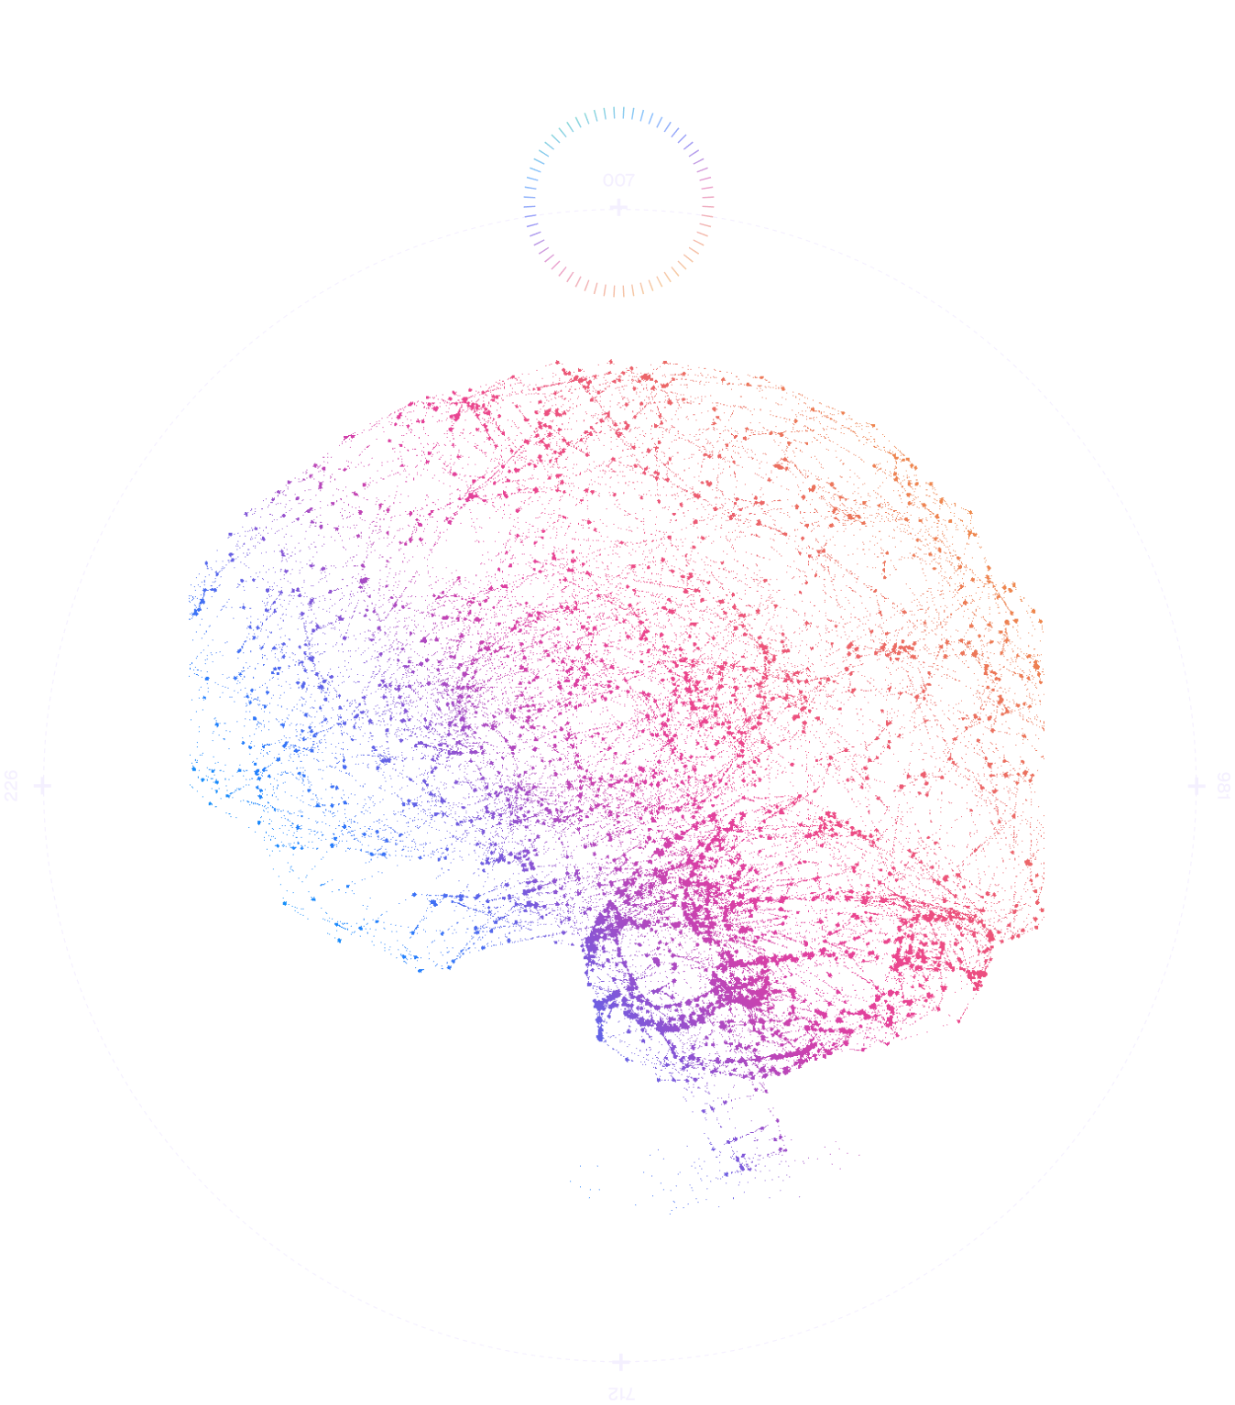
Assessing AI Readiness ​
1
EVALUATE DATA INFRASTRUCTURE​
Assess the scalability and reliability of data systems to support AI​ initiatives and future growth ​​
REVIEW GOVERNANCE & COMPLIANCE​
A
2
Ensure frameworks address regulatory standards and safeguard ​data security for AI deployment​
3
IDENTIFY SKILLS & AI LITERACY GAPS​
Assess team’s AI skills and literacy to identify gaps and training​ needs​
4
DEFINE ROADMAP & ALIGNMENT​
Create an initial plan aligning organizational goals with AI​ capabilities for scalable adoption​

Slide 9
Express Setup Essentials
PRE-WORKSHOP REQUIREMENTS
WORKSHOP DELIVERABLES
Access to relevant stakeholders (business + IT + data)​
Agreement on workshop scope (focus areas, challenges)​
Availability of business process documentation/data overviews
Workshop report
Initiative portfolio
ROI-cost map
Roadmap draft
WORKSHOP FORMAT
COST
Duration: 5–10 days​
Example setup: 5 days of which 4 are 2x2h daily sessions followed by a summary and a report on the 5th day​
Format: Onsite / Hybrid
Fixed workshop fee: EUR 6500 / 10 days​
Includes preparation, facilitation, reporting

Slide 10


Expected Business Impact Timeline
Month 1-3
Foundation & Quick Wins
Month 4-9
Efficiency Gains
Month 10-18
Strategic Value
Process optimization and automation
Tool implementation and integration
Team capability development
Operational improvements delivery
Cost reduction realization
Stakeholder confidence building
Revenue generation initiatives
Competitive advantage development
Sustainable AI capability establishment

Slide 11





Choose MASTER Workshop If:
Ready for a comprehensive AI Strategy
Complex organizational environment
Significant investment planning (>€500k)
Detailed implementation guidance needed
We offer an EXPRESS WORKSHOP as an alternative to the Master format: ideal for organizations looking to quickly evaluate AI opportunities without the need for extensive preparation or in-depth discovery.

Slide 12



Contact for workshop scheduling and customization options
ai@kolomolo.com

